Slide 1
Keyword Detection using Qkeras
By Pratishtha Bhatia

Slide 2

Study Objectives
The Objective is to detect the Key words- "down", "go", "left", "no", "right", "stop", "up" and "yes" from 1 second Audio clip using a Quantized layers in Qkeras.

Slide 3
Methodology
Research on existing Keras Models
Analysis
Data Study
Comparison
A Simple Keras model was selected as a starting point for training a quantized NN Model.
The learning rate, Dropout layer and No. of epochs were varied to find the best fit.
The 1 second Audio Samples were converted to Spectrograms and resized to reduce the training time.
The Quantized Model was compared with the the existing Keras Model.

Slide 4
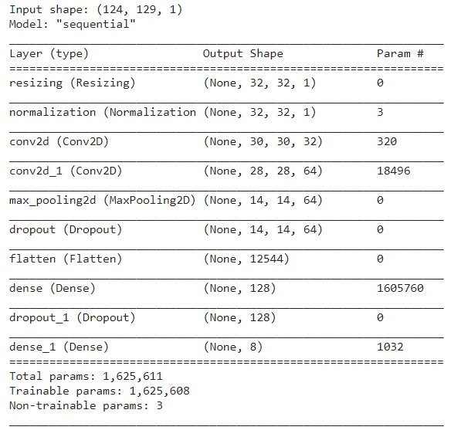
Research on Existing Keras Models
A Model with the architecture shown alongside was taken as the starting point.
The Keras layers used in the model were replaced with Quantized layers from Qkeras Library.

Slide 5
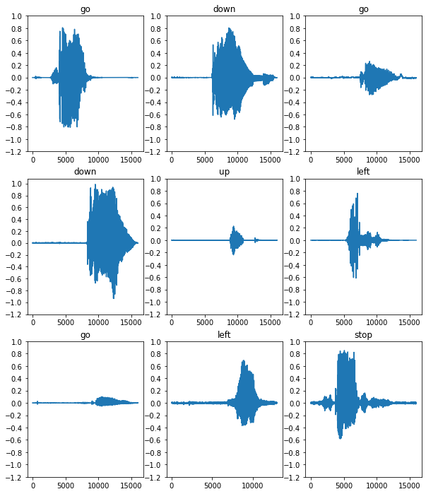
Data Study
Audio Waveform
The Audio Waveform for each of the Keywords was examined.This represents the Amplitude of the signal at the specific time

Slide 6
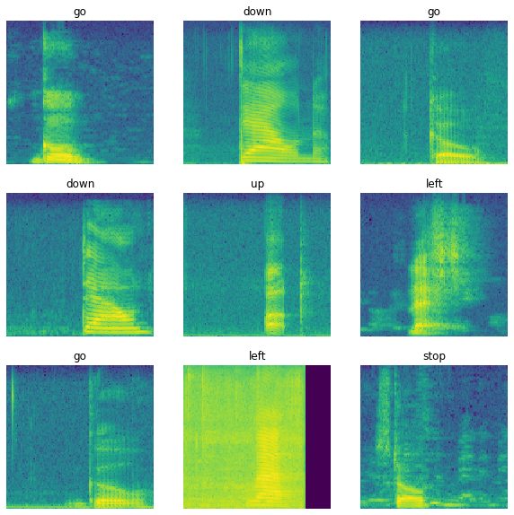
Data Study
Spectrogram
The Audio Waveform was converted to a spectrogram by done by applying the short-time Fourier transform (STFT) to convert the audio into the time-frequency domain.

Slide 7
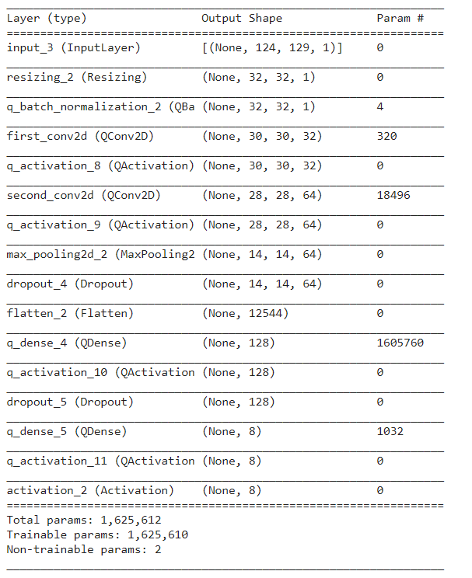
Network Architecture
A Model with the architecture shown alongside was considered with Quantized Convolution layers, Quantized Batch Normalization layer, QDense Layer and Quantized Activation functions taken from the Qkeras Library.

Slide 8
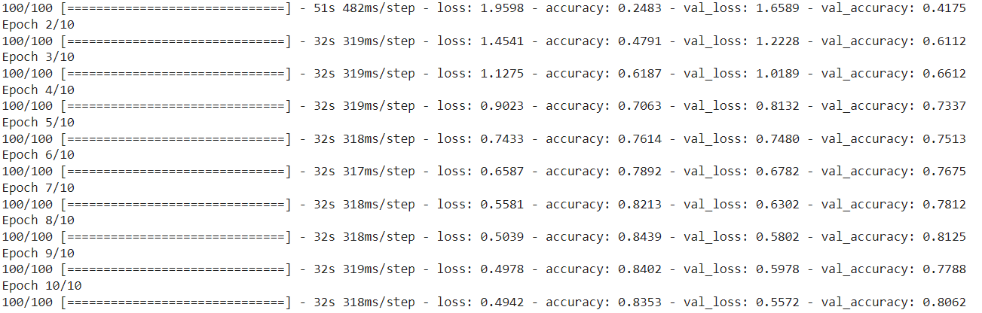
Analysis
10
82%
84%
78%
Epochs
Test Accuracy
Keras

Slide 9
Analysis
Effect of Resizing
By using Keras Layer for Resizing, the Input layer was resized to height=32 and width= 32. This resulted in a reduction of training time by 12 times.

Slide 10
Analysis
Effect of Learning Rate
Learning Rate | Test Accuracy
0.001 | 71 %
0.0001 | 68%
0.0005 | 78%
0.00075 | 82%
The Learning rate was varied to avoid underfitting/overfitting and arrive at the best accuracy with Dropout 0.35 for both the dropout layers.

Slide 11
Analysis
Effect of changing the Dropout
Dropout | Test Accuracy
0.25 and 0.5 | 51 %
0.25 and 0.4 | 80%
0.25 and 0.35 | 78%
0.35 and 0.35 | 82%
The Dropout values in both the layers were varied to achieve the highest Test Accuracy with learning rate= 0.00075.

Slide 12
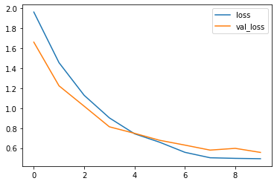
Results
The Training and Validation Loss is seen to decrease as the No. of epochs increase.
Learning Rate | 0.00075
Batch Size | 64
No. of Epochs | 10
Training Accuracy | 84.02%
Validation Accuracy | 80.62%
Test Accuracy | 82%

Slide 13
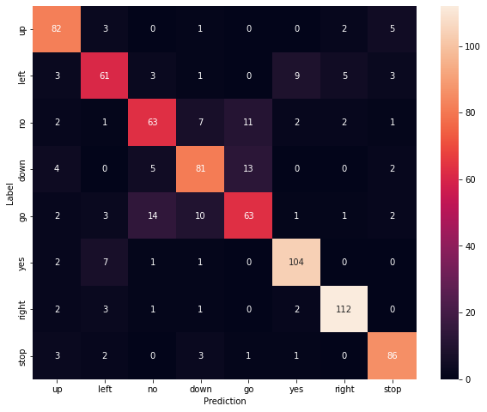
Results
Confusion Matrix
The Confusion Matrix depicts the the prediction for each of the commands in the test set.

Slide 14
Comparison
Accuracy: Keras v/s Qkeras
84%
82%
The Test Set Accuracy obtained for Qkeras is quite close to the test set Accuracy obtained for Keras indicating a good fit.
Keras
Qkeras

Slide 15
Thank You!

